Slide 1
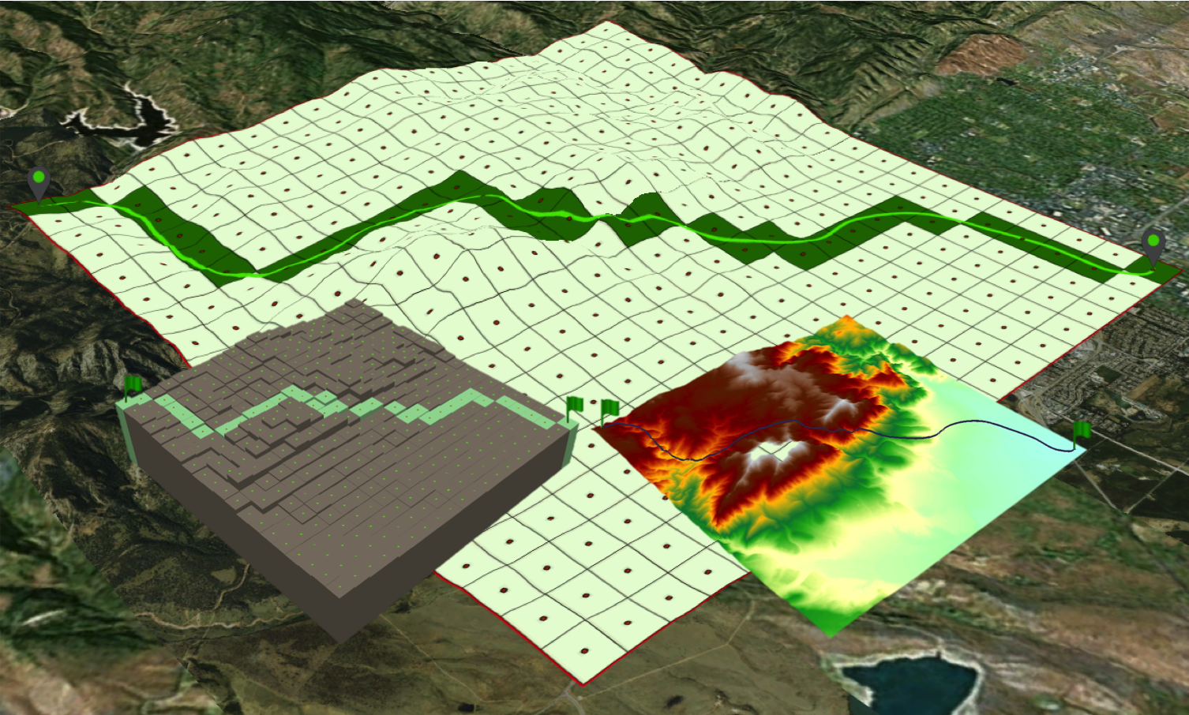

July 7th, 2017
Cross-Scale Analysis of Sub-Pixel Variations in Digital Elevation Models
Mehran Ghandehari, Barbara P. Buttenfield, and Carson J. Q. Farmer
Department of Geography, University of Colorado, Boulder
{mehran.ghandehari; babs; carson.farmer} @colorado.edu
Notes:
Hello Everyone.
thank you so much for coming to my presentation. I am very delighted to be here presenting my research on …
I am Mehran …
I also want to acknowledge my co-authors, babs buttenfield and Carson Farmer, both faculty at University of Colorado-Boulder.

Slide 2
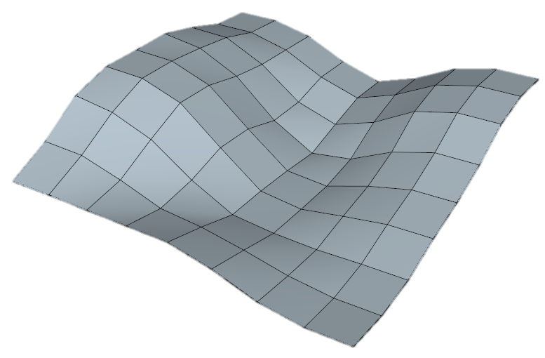
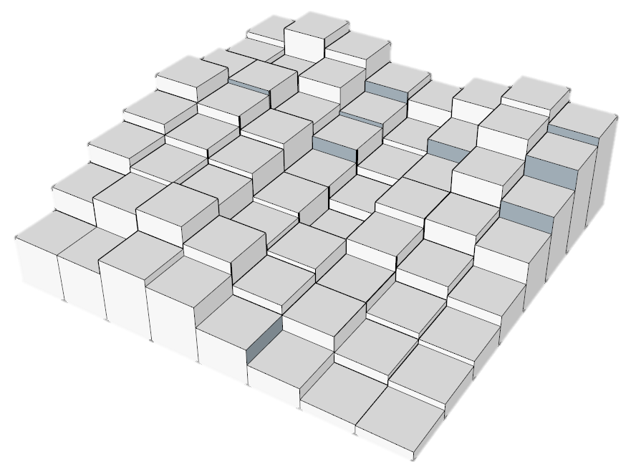
Introduction
Intro
Methods
Results
Summary
Rigid pixel paradigm
Surface-adjusted paradigm
02/12
Notes:
In digital elevation models, the terrain surface is modeled on a grid of pixels. The assumption is that elevation is constant within each pixel. It is obvious that this model leads to imprecise measurements because it does not account for the slope and curvature of the terrain within each pixel. As pixel size increases, for example in continental or global scale modeling, errors introduced by the rigid pixel paradigm can become dramatic.
In this research, we relax the assumption of rigid pixels and acknowledge sub-pixel variations in elevation
More specifically we look for possible sub-pixel variations to be used to interpolate elevation of arbitrary points from a regular grid.

Slide 3
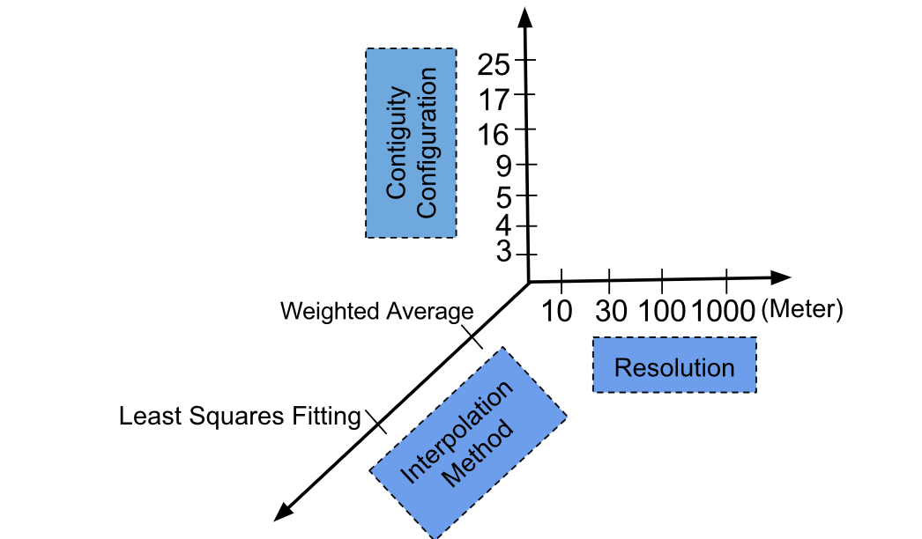
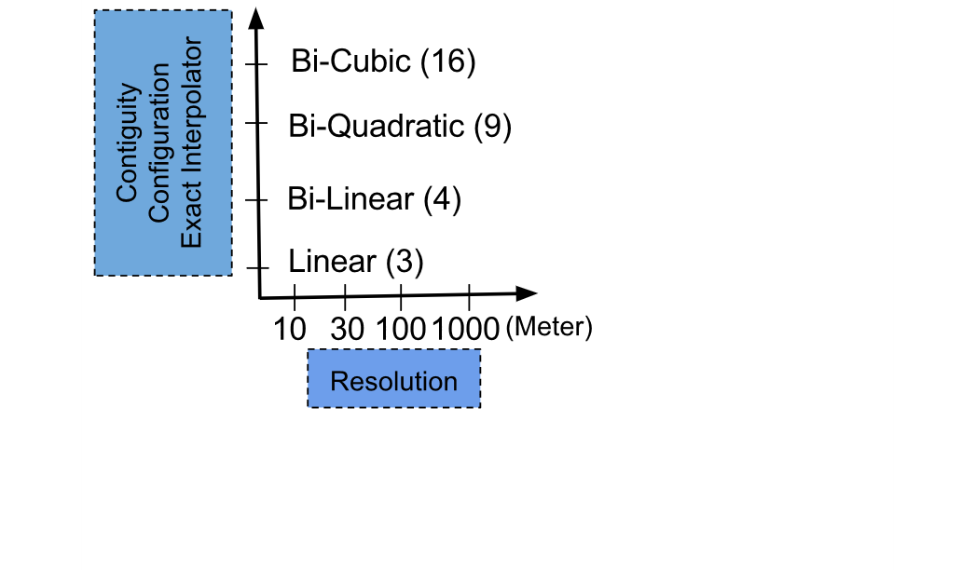
Methods
Intro
Methods
Results
Summary
03/12
Notes:
Our research methods compare elevation estimates made off-centroid, randomly, within each pixel, using different interpolation methods and neighborhood configurations. We also examine the sensitivity of surface adjustment to a progression of spatial resolutions
On the right, you see several polynomial interpolation methods, that are exact interpolators and are tested only on one configuration. On the left, you see that Least Squares Fitting and Weighted Average methods are tested on all configurations to determine which neighborhood gives the lowest errors. The methods are validated against a 3m LiDAR benchmark. Let me show you the configurations.

Slide 4
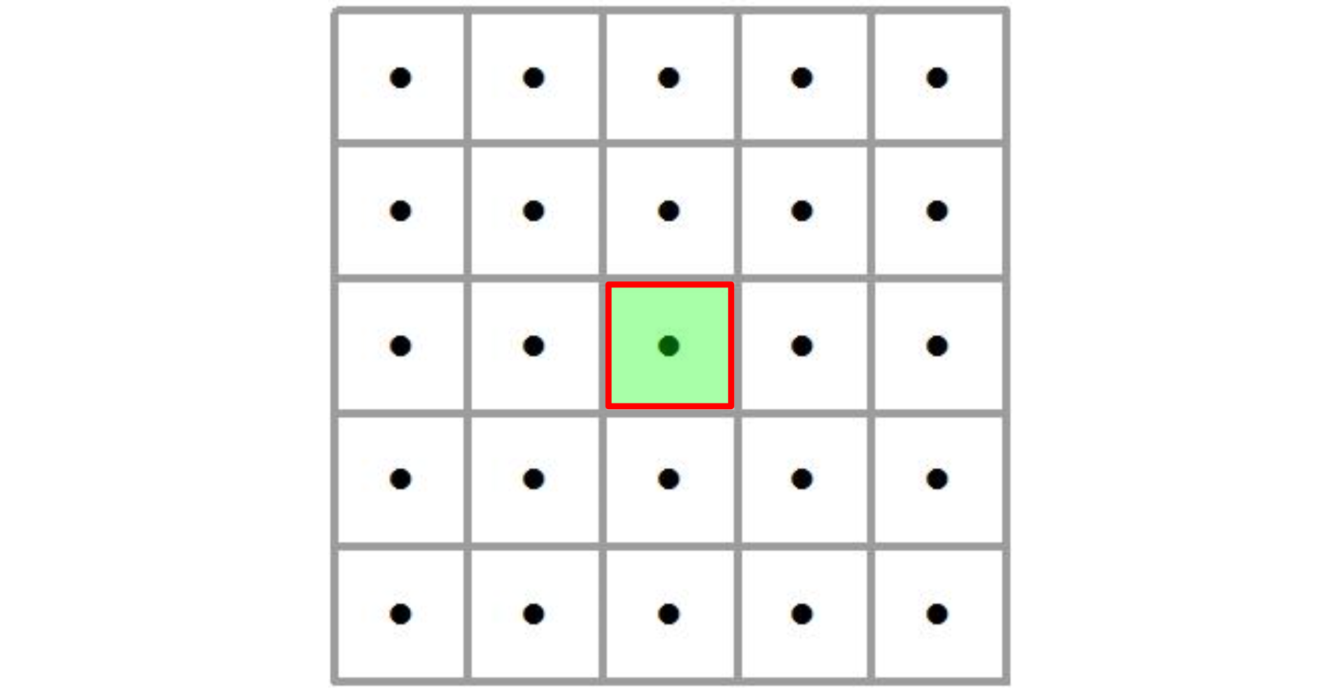
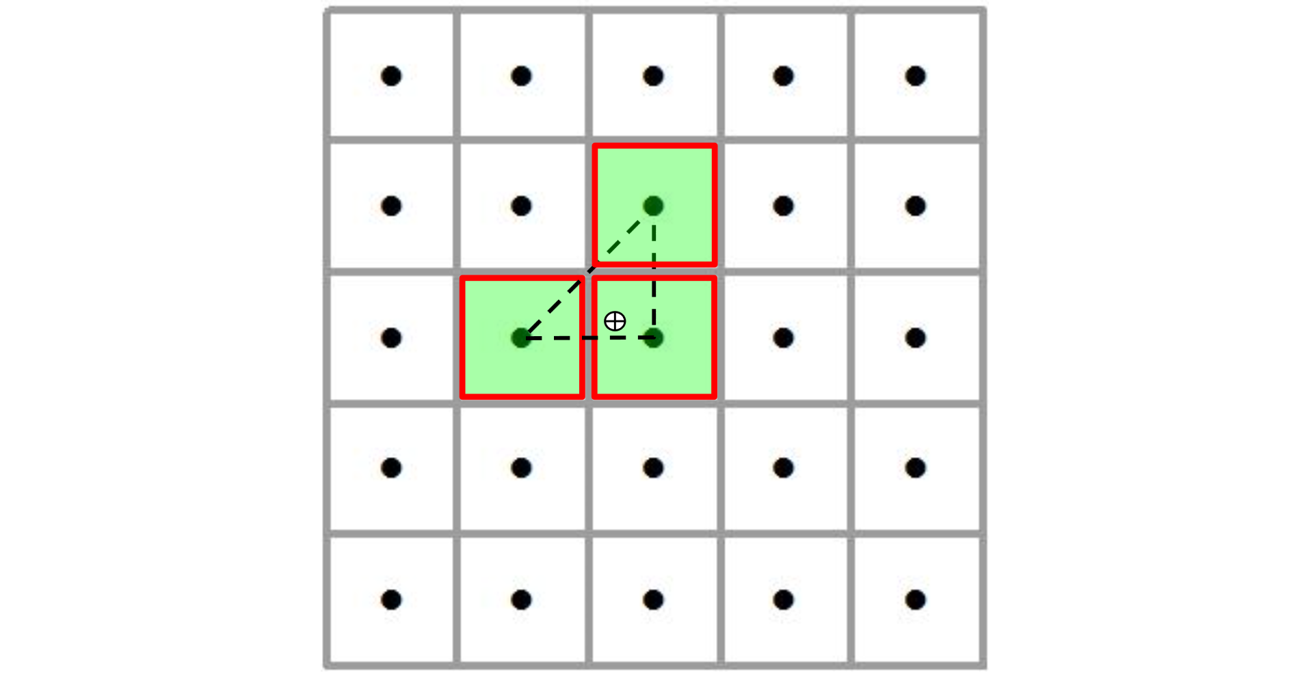
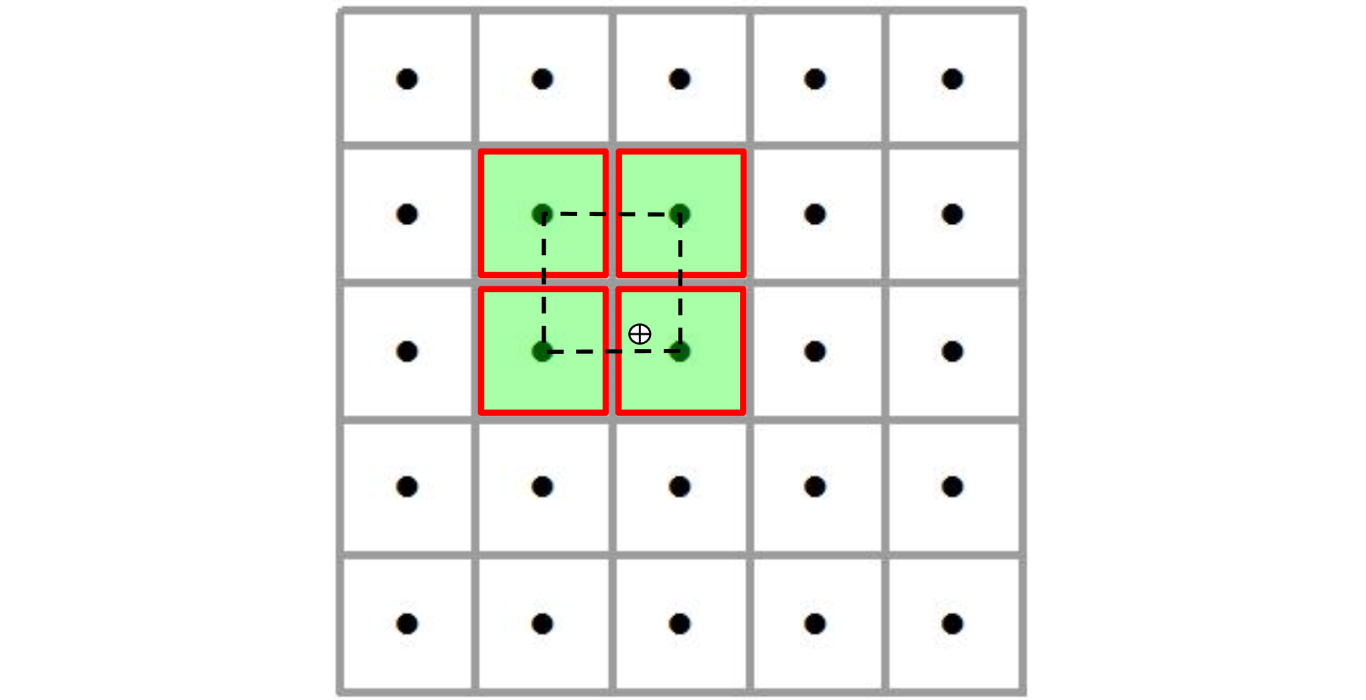
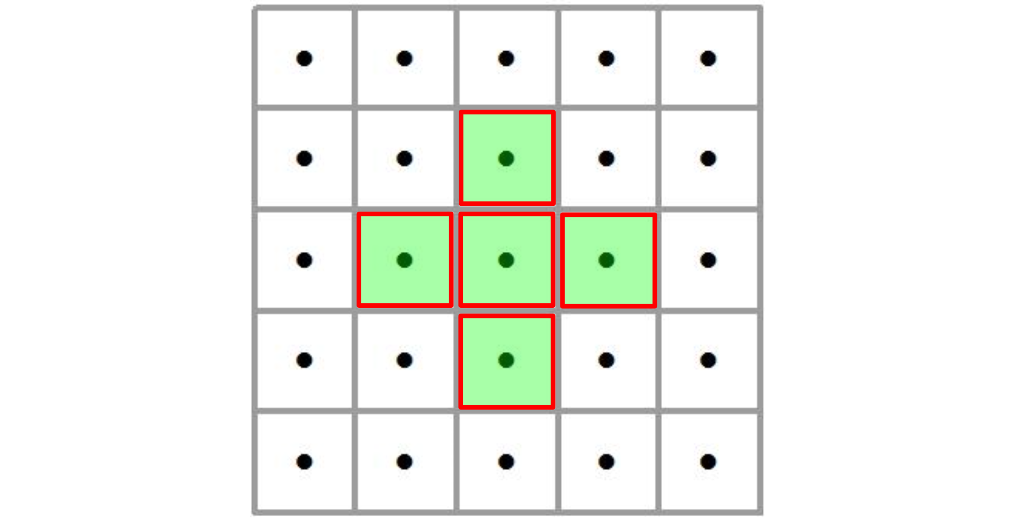
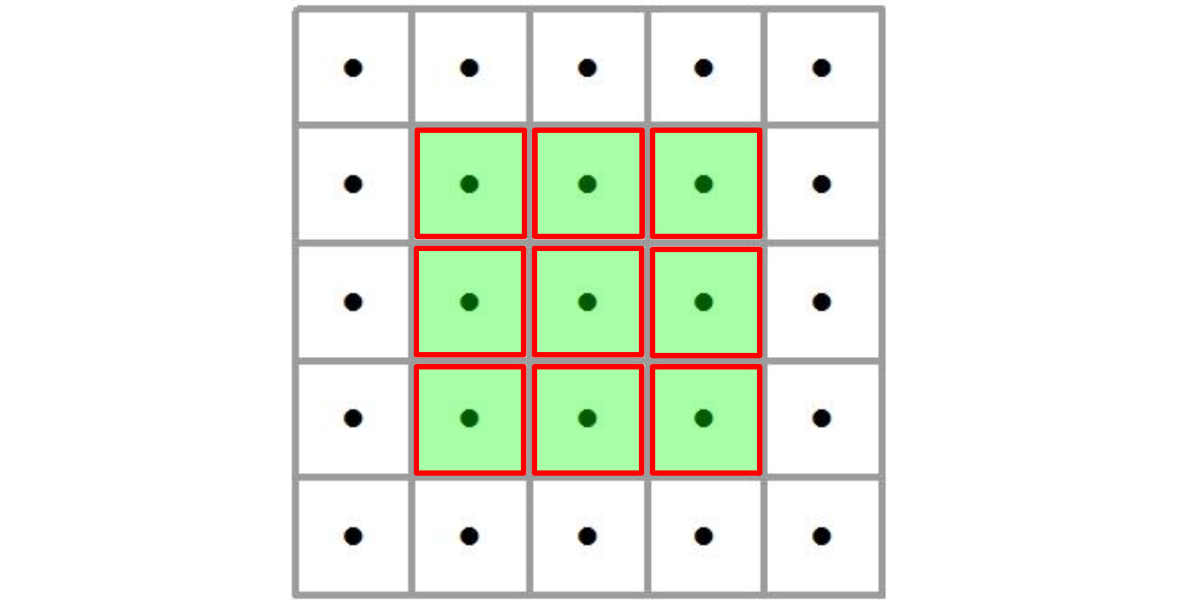
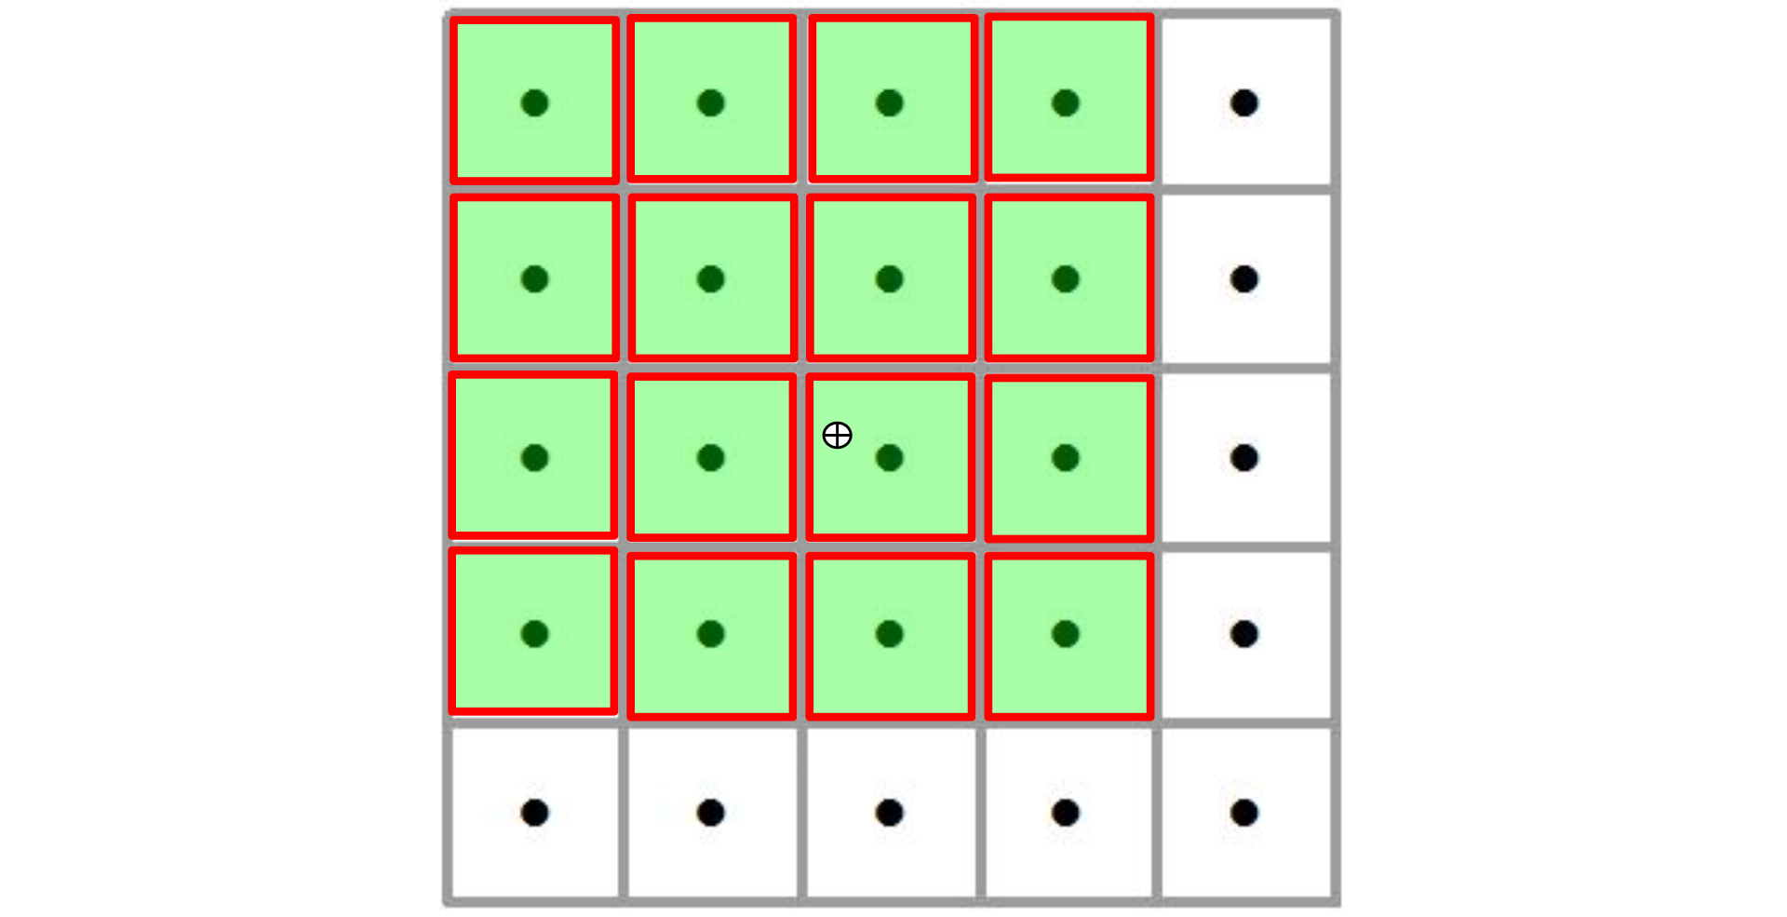
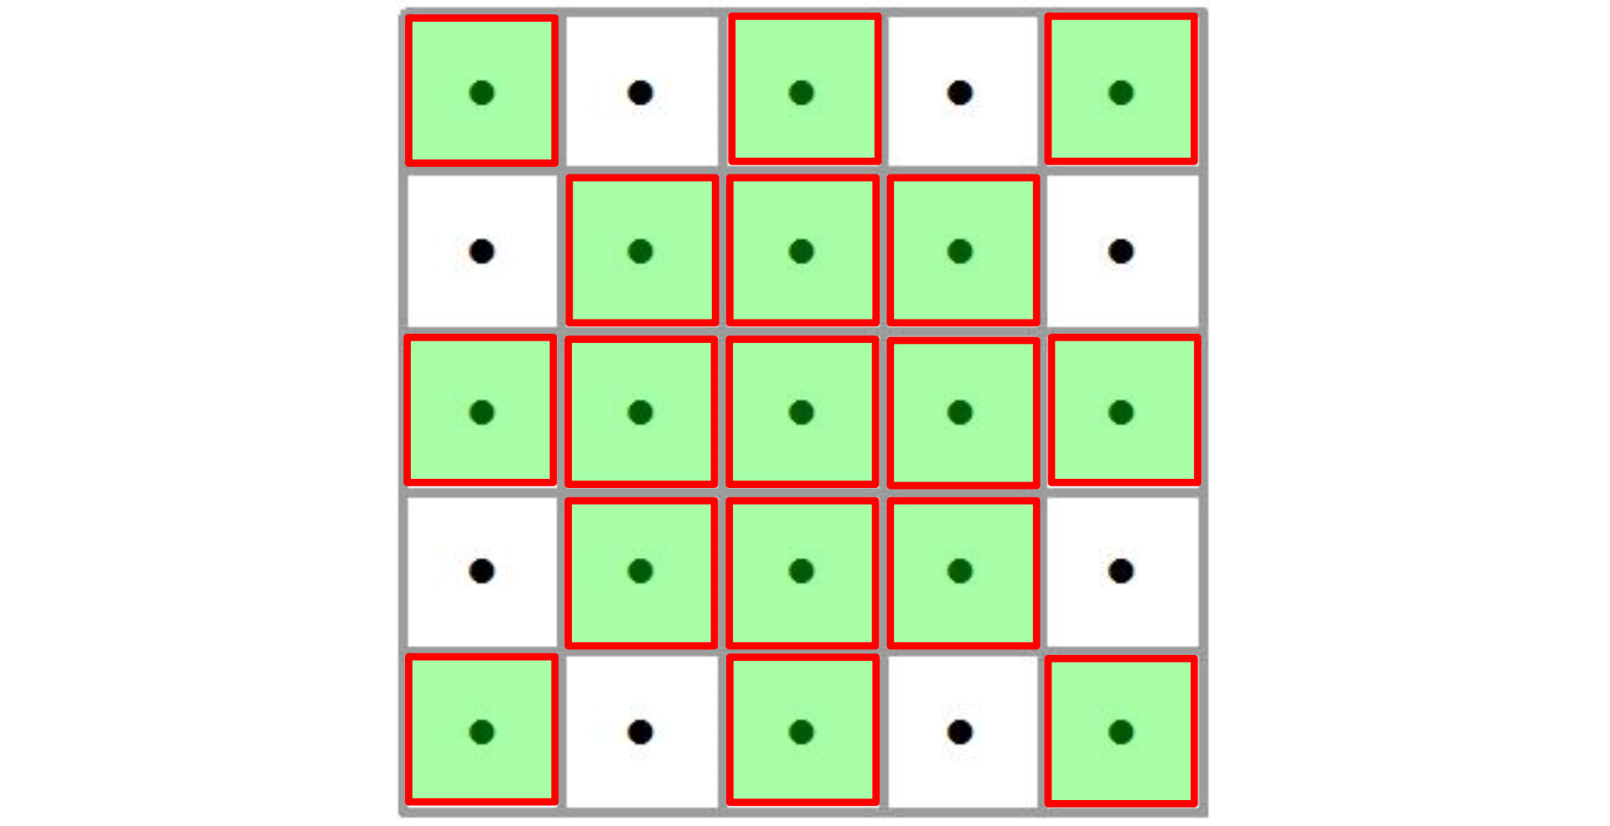
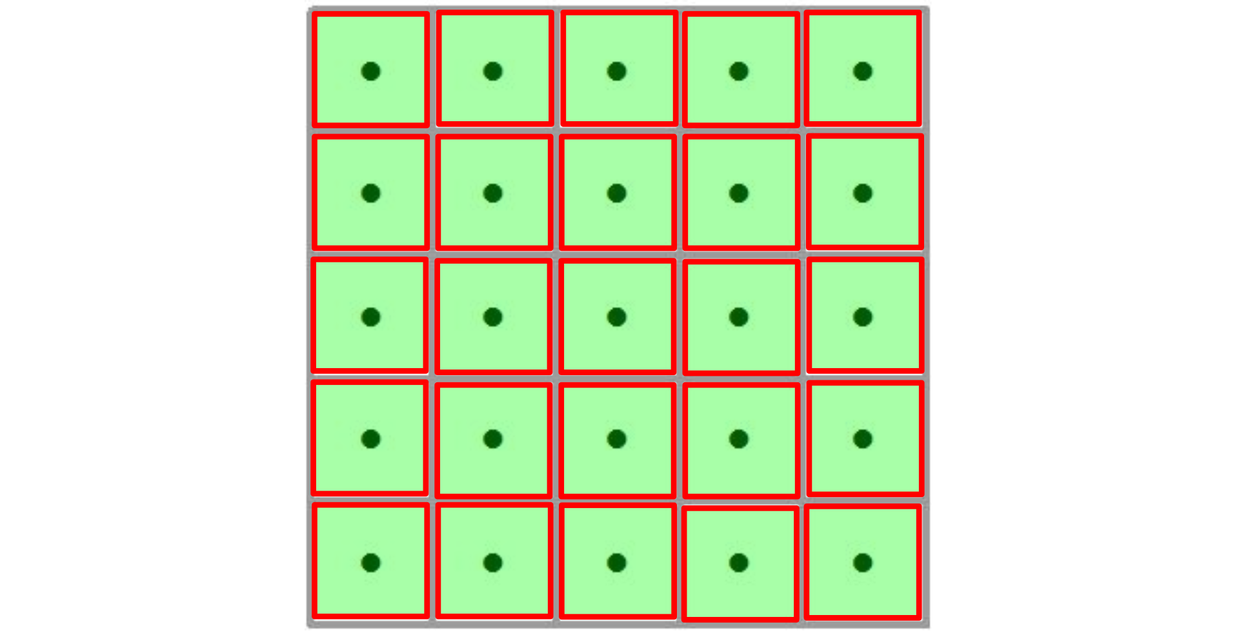
Methods: Contiguity Configurations
Intro
Methods
Nearest Neighbor (1)
Linear (3)
Bi-Linear (4)
5.
Results
Summary
Bi-Quadratic (9)
Bi-Cubic (16)
17
25
04/12
Notes:
In the upper left, the Nearest Neighbor uses only one pixel – this method will be used for the 3m LiDAR validation. Other configurations are also shown; and keep in mind that the polynomial exact interpolators operate on one configuration, while two other methods will be examined within all configurations.

Slide 5
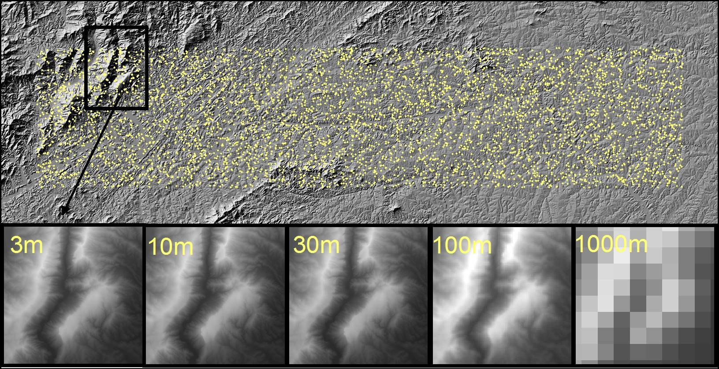
Methods: Data Sets and Study Areas
Intro
Methods
Results
Summary
05/12
Notes:
The study area is in North Carolina which was chosen based on the availability of 3m resolution lidar data to be used for validation. Notice that the terrain is rougher in the northwest corner, a point I will return to in discussing residuals.
Data sources for the 3m, 10m, and 30m resolutions are the USGS National Elevation Dataset
The source for 100m and 1000m resolution data is the Shuttle Radar Topography Mission (SRTM) dataset

Slide 6
Methods: Workflow and Processing
Intro
01
Load 4 Input DEMs (DEM10, DEM30, DEM100, DEM1000)
02
Load benchmark (DEM3)
Methods
03
Generate sample of 20,000 random points in the study area
04
For i in 20,000 random points:
For j in 4 Input DEMs:
For k in 6 interpolation methods:
- Interpolate the elevation of point i based on the DEM resolution j using interpolation method k (Elev_{ijk})
- Compute Residual_{ijk} = Elev_{ijk} – Elev_{i} of benchmark
Results
Summary
05
Accuracy Assessment (RMSE, Standard Deviation, etc.)
06/12
Notes:
Here is the workflow of our research:
Then a nested loop processes each point for all DEMs and for all interpolation methods to calculate the residual for that point
Finally the residuals are summarized with RMSE

Slide 7
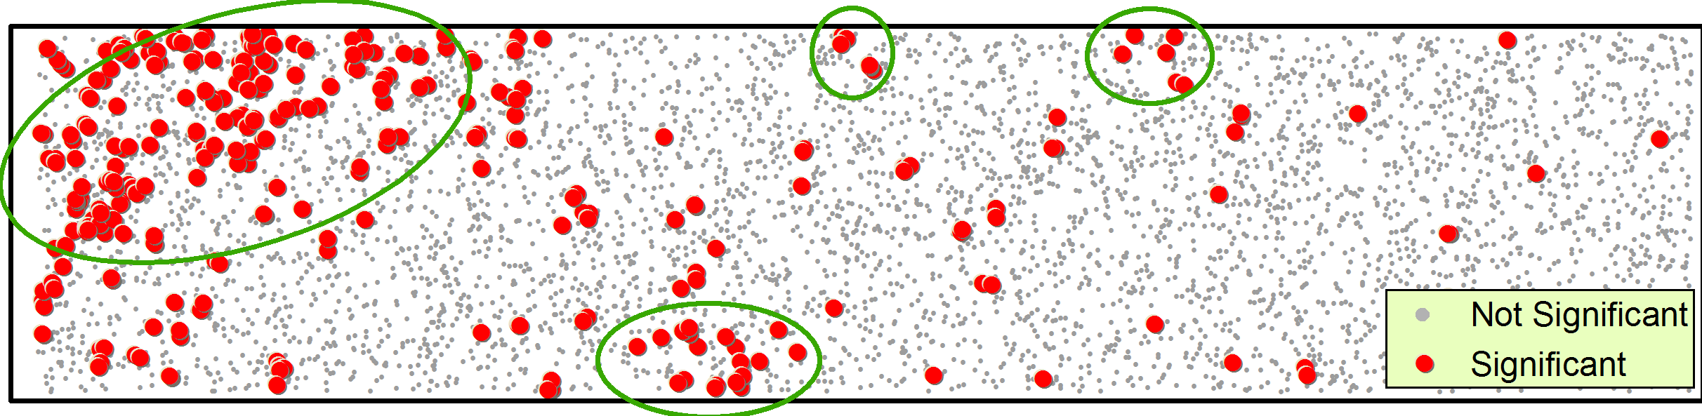
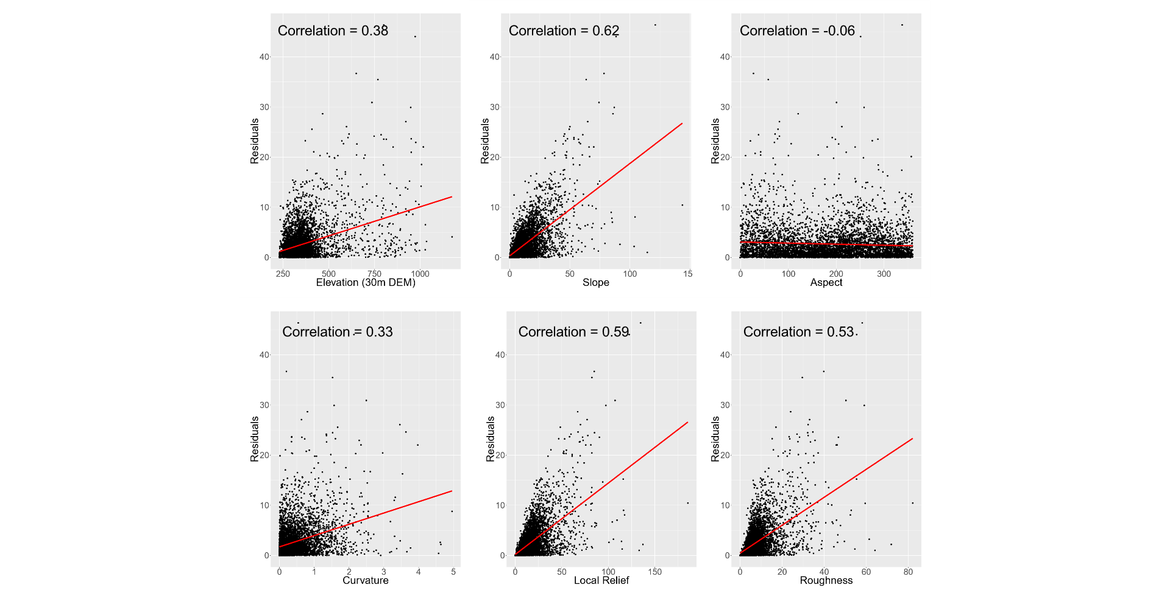
Results: Analysis of Residuals
Intro
Methods
40
Results
Residuals
30
20
Summary
10
0
0
100
200
300
0
1
2
3
4
5
200
600
1000
0
20
40
60
80
0
50
100
150
Aspect
Curvature
Elevation
Roughness
Slope
07/12
Notes:
The upper figure shows the spatial distribution of residuals of bilinear method from 30m DEM . You can see spatial heterogeneity due to the varied character of terrain. The circles in the upper Figure highlight significant residual clusters and illustrate that many are situated in rough terrain
The figures across the bottom illustrate the correlation between the residuals and various terrain derivatives.
All of the correlation coefficients are highly significant, except aspect and where the scatter plots do not show a strong pattern, significance is due probably to the large number of sample points (20,000). Slope has the highest correlation with the residual, indicating the accuracy of estimated elevations in steeper slopes is lower than on flatter slopes

Slide 8
Optimal Configuration for Weighted Average Interpolator (RMSE values)
Intro
Contiguity Configuration | 10m | 30m | 100m | 1000m
WA3 | 0.90 | 2.14 | 8.36 | 23.86
WA4 | 0.89 | 2.12 | 8.33 | 23.96
WA5 | 0.92 | 2.22 | 8.50 | 24.94
WA9 | 0.91 | 2.20 | 8.52 | 25.63
WA16 | 0.90 | 2.21 | 8.58 | 26.63
WA17 | 0.91 | 2.24 | 8.62 | 26.64
WA25 | 0.93 | 2.31 | 8.75 | 27.69
Methods
Results
RMSE
Summary
Distance Power
08/12
Notes:
This table shows the RMSEs resulting from the Weighted Average method for all contiguity configurations, and across all resolutions.
As you can see, WA4 has the lowest RMSE in all resolutions and was chosen as the optimum contiguity configuration
Also we tested various distance power used in WA in different resolutions ,and it seems, 2 is an appropriate distance power

Slide 9
Optimal Configuration for Least Squares Fitting (RMSE values)
Intro
Polynomial order | Contiguity Configuration | 10m | 30m | 100m | 1000m
1 | 4 | 0.88 | 2.10 | 8.34 | 24.08
 | 5 | 0.88 | 2.17 | 8.51 | 26.48
 | 9 | 0.90 | 2.33 | 8.83 | 29.84
 | 16 | 0.97 | 2.74 | 9.51 | 34.70
 | 25 | 1.09 | 3.26 | 10.25 | 38.48
2 | 9 | 0.89 | 2.22 | 8.60 | 25.65
 | 16 | 0.92 | 2.48 | 10.13 | 29.10
 | 17 | 0.93 | 2.52 | 9.67 | 30.82
 | 25 | 0.99 | 2.81 | 10.28 | 32.65
3 | 9 | 0.89 | 2.22 | 8.71 | 26.00
 | 16 | 0.92 | 2.46 | 8.97 | 28.17
 | 17 | 0.93 | 2.50 | 9.06 | 29.77
 | 25 | 0.99 | 2.79 | 9.49 | 31.88
4 | 16 | 0.92 | 2.46 | 8.97 | 27.54
 | 17 | 0.93 | 2.50 | 9.06 | 29.46
 | 25 | 0.99 | 2.79 | 9.49 | 30.41
Methods
Results
Summary
09/12
Notes:
This table shows the RMSEs for the least squareS fitting. Different polynomial orders and number of neighbors are tested. Note that higher order polynomials require larger neighborhoods, meaning that not all configurations can be tested. Also, the RMSEs increase at coarser resolutions.
Although the values for several configurations are quite similar to those in the orange shaded box, polynomial order 1 with contiguity configuration 4 has the lowest RMSE. This method was selected for further analysis
the difference between 0.88 and 0.89 is pretty small, and that you chose the 1st order polynomial because it is a simpler equation and therefore faster to compute.
a paler shade of orange

Slide 10
Comparing Surface-Adjusted Methods (RMSE Values)
Intro
 | Li3 | BiLi4 | LSqF4 | WA4 | BiQ9 | BiC16
10m | 0.88 | 0.88 | 0.88 | 0.89 | 0.90 | 0.97
30m | 2.10 | 2.10 | 2.10 | 2.12 | 2.33 | 2.74
100m | 8.34 | 8.34 | 8.34 | 8.33 | 8.83 | 9.51
1000m | 24.03 | 24.08 | 24.08 | 23.96 | 29.85 | 34.72
Methods
Results
 | WA4 | Li3 | BiLi4 | LSqF4 | BiQ9 | BiC16
Run time for 20,000 sample points (seconds) | 2.48 | 6.79 | 7.35 | 7.44 | 9.12 | 16.52
Summary
10/12
Notes:
The upper table shows the comparison among all surface-adjusted methods. Across the top table, columns identify the method and the configuration (READ THEM TO THE AUDIENCE). Columns are arranged to show increasing neighborhood sizes, left to right. At finer resolutions, the linear and bilinear polynomials give the lowest RMSE, while Weighted Average gives lowest RMSE values at coarser resolutions. All of these low RMSE values are very close in magnitude.
The lower table shows run times in seconds to interpolate 20,000 off-centroid elevations. The WA4 gives the fastest run time, even though its neighborhood is essentially the same size as three of the polynomials. Given that one wants to balance processing time with accuracy, WA4 seems to be an optimal choice, when working with a very compact neighborhood.
Orange indicates the lowest RMSE in each resolution. The pale orange illustrates the RMSEs that are 2nd lowest.

Slide 11
Summary
Intro
Cross-scale analysis of elevation estimates across resolutions shows varying amounts of error and processing speed.
Error magnitudes vary with DEM resolution and interpolation method
General increase in the residuals at coarser resolutions
RMSE values are very close for 10m DEM: hard to distinguish optimal value for any single method
Bi-Cubic: highest magnitude errors
Weighted Average, Linear, Bi-Linear, and Best Fit: lowest RMSE
Weighted Average shows nearly lowest or lowest RMSE and fastest computations
Methods
Results
Summary
11/12
Notes:
Let me sum up the main ideas:

Slide 12
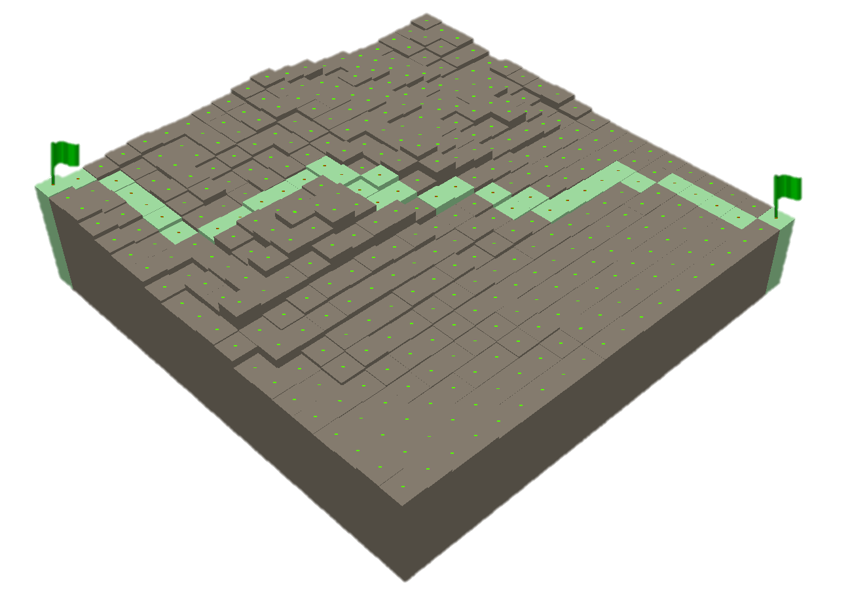
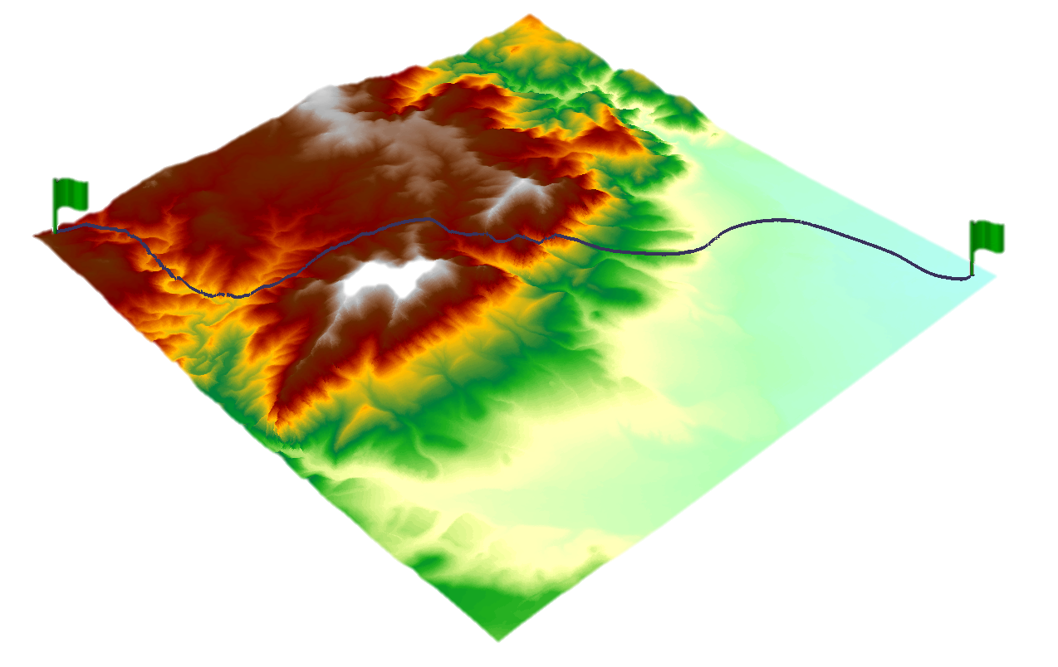
Ongoing and Future Work
Intro
Other terrain types (Flat, Hilly, Mountainous, Uniform, Non-Uniform)
Other metrics (Distance, Area, Volume) adjusting for (Slope, Curvature)
Modeling applications (Flow Accumulation, Flood inundation, Debris Flows, Earthquakes, etc.)
Methods
Results
Summary
12/12
Notes:
Future work for elevation estimation will apply comparative analysis to other terrain types (flat, hilly, mountainous, and uniform, non-uniform). The research team at Colorado has ongoing work on surface-adjusted methods for distance, area and volume, accounting for adjustment with slope alone, and with slope and curvature. The team is also working on a variety of modeling applications integrating surface-adjusted metrics – the team includes the three of us as well as another GIScientist and two Geologists.
Thanks for your attention

